Slide 1
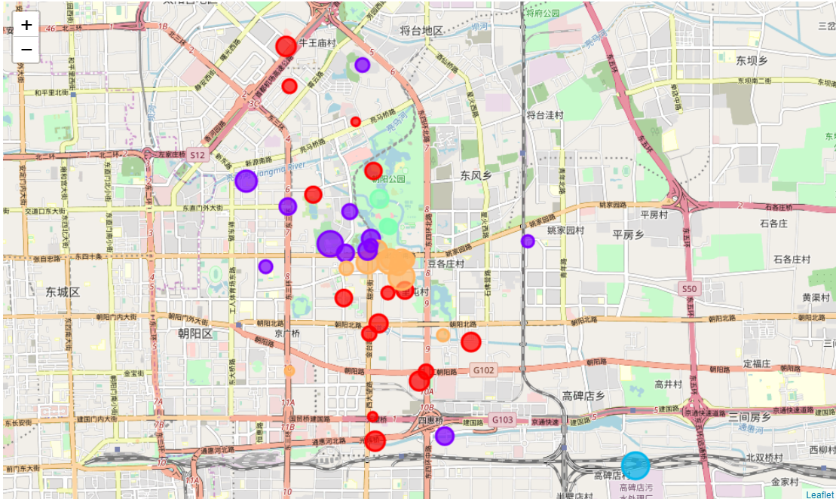
IBM Data Science Capstone Project Report
Beijing Chaoyang District Airbnb Data Analysis
Lorin Zhao

Slide 2



Backgrounds
Why do I want to do this project?
There are more than 11,000 Airbnb rooms listed in data set published by "public.opendatasoft.com". For potential investors who want to start a Airbnb business in Beijing, it would beneficial to conduct an analysis based on location, and see if there is any correlation between location features and Airbnb monetization. And for both investors and travelers, they will be benefited from a visualization color coded each Airbnb asset with its segmentation associated with its location features.
Why data have I used?
Airbnb listing data from "public.opendatasoft.com“
API provided by "Foursquare" to find common venues

Slide 3
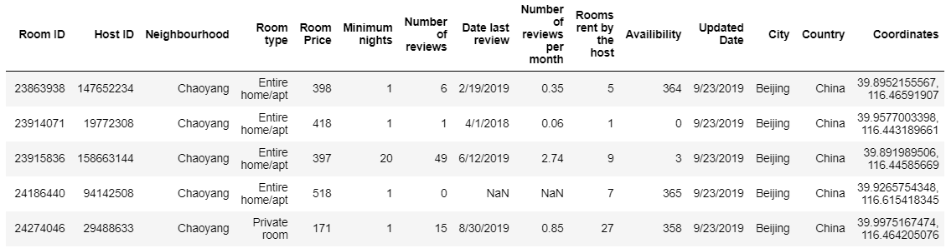
Data Process (1/3)
Raw Data
There are many fields which may not useful to our analysis, so we will drop them, but remaining: "Coordinates", to find location features through Foursquare API calls; "Room price", as indication ability of monetization; And "Room type" as we want to only use the most common room type for analysis, as room type itself is a independent variable which price may depend on.

Slide 4
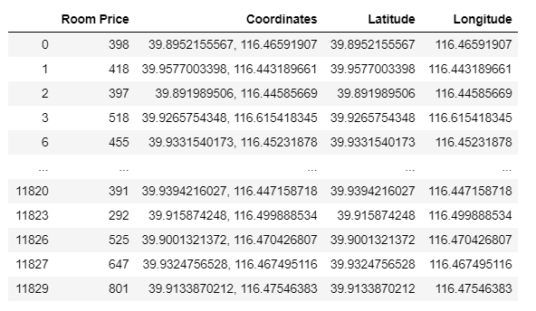
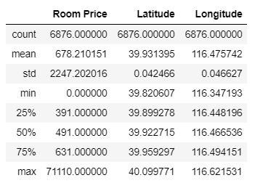
Data Process (2/3)
Location Base Data
I choose 3 key columns which are price, latitude and longitude
See right table of data description: price range is big enough for analysis

Slide 5
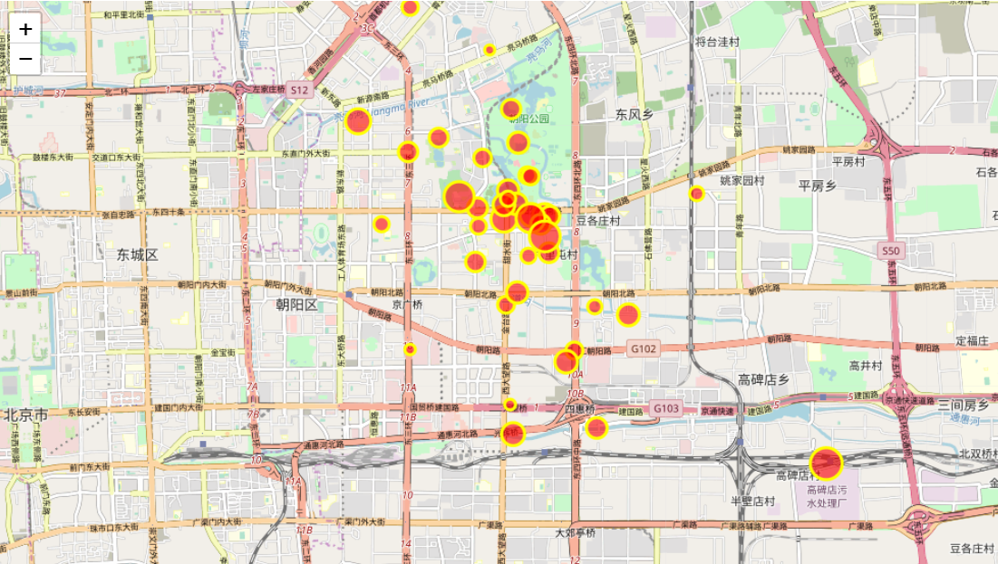
Data Process (3/3)
DBSCAN (10,000+ Rooms to 40 Neighbourhoods)
There are more than 10,000 records, which is hard to show on map
For rooms too close with each other, there won’t be much difference in terms of location features
So we did DBSCAN (Density Based Scanning) on coordinates to further group rooms into neighborhoods
epsilon = 0.003 (0.003 change in latitude and longitude can draw a reasonable size of area on map)
Minimum Samples = 7

Slide 6
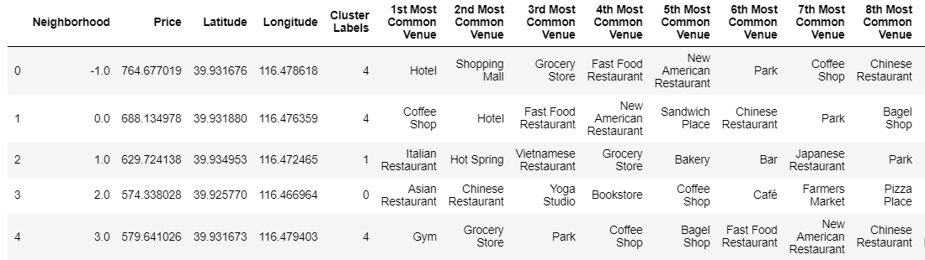
Data Segmentation
Add Location Features and Segment based on features
Add most common venues using Foursqure API and runed K Nearest score to cluster neighborhoods into Clusters
5 Clusters found based on K Nearest Algorithm

Slide 7
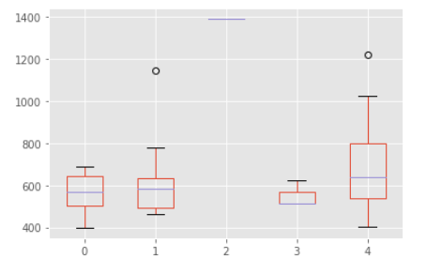
Data Segmentation Differentiations
Naming each Cluster and draw box plot to examine price differentiations
Cluster 0: Coffee Shop Area
Asian Restaurant 3
Coffee Shop 7
Convenience Store 1
Hotel 2
Japanese Restaurant 2
Cluster 3: Park Area
Park 2
Tennis Court 1
Box chart: although it’s not very significant, the chart shows Antique shop area and Modern Lifestyle area out performs in price
Cluster 1: Foreign Restaurants Area
Chinese Restaurant 1
Cocktail Bar 1
Grocery Store 2
Hotpot Restaurant 1
Italian Restaurant 4
Mexican Restaurant 1
Noodle House 1
Yunnan Restaurant 1
Cluster 4: Modern Lifestyle Chinese Restaurant 2
Coffee Shop 4
Coworking Space 1
Gym 1
Hotel 3
Cluster 2:
Antique Shop 1

Slide 8
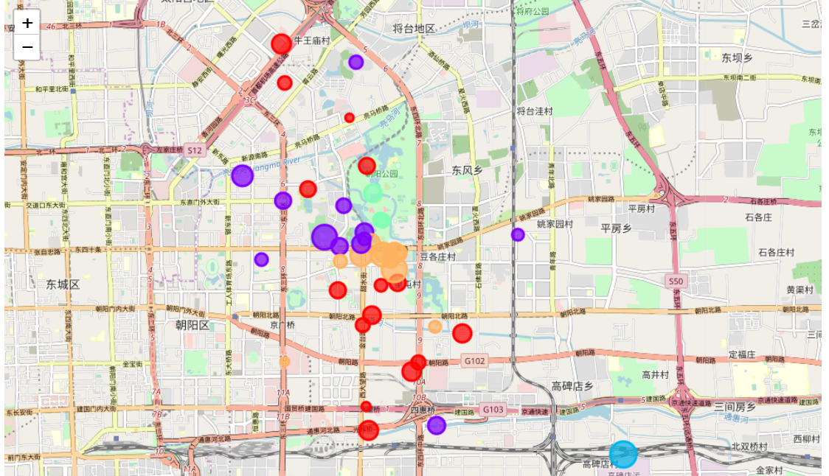
Visualization
Visualize each area on Map with price indicator (bubble size) as a tool for reference
Cluster 0: Coffee Shop Area
Asian Restaurant 3
Coffee Shop 7
Convenience Store 1
Hotel 2
Japanese Restaurant 2
Cluster 3: Park Area
Park 2
Tennis Court 1
Cluster 4: Modern Lifestyle Area
Chinese Restaurant 2
Coffee Shop 4
Coworking Space 1
Gym 1
Hotel 3
Cluster 1: Foreign Restaurants Area
Chinese Restaurant 1
Cocktail Bar 1
Grocery Store 2
Hotpot Restaurant 1
Italian Restaurant 4
Mexican Restaurant 1
Noodle House 1
Yunnan Restaurant 1
Cluster 2:
Antique Shop 1

Slide 9
Thank you!

